Slide 1


PYTHON
Lecture 24

Slide 2

Today’s Agenda
List -I
What Is A List ?
Creating A List
Accessing The List Elements
Adding New Data In The List
The Slice Operator With List

Slide 3
What Is A List ?
Unlike C++ or Java, Python doesn’t has arrays.
So , to hold a sequence of values, Python provides us a special built in class called ‘list’ .
Thus a list in Python is defined as a collection of values.

Slide 4
Important Characteristics Of A List
The important characteristics of Python lists are as follows:
Lists are ordered.
Lists can contain any arbitrary objects.
List elements can be accessed by index.
Lists can be nested to arbitrary depth.
Lists are mutable.
Lists are dynamic.

Slide 5
How To Create A List ?
In Python, a list is created by placing all the items (elements) inside a square bracket [ ], separated by commas.
It can contain heterogeneous elements also.
# empty list
my_list = []
# list of integers
my_list = [1, 2, 3]
# list with mixed datatypes
my_list = [1, "Hello", 3.4]

Slide 6
Other Ways Of Creating List
We also can create a list by using the list( ) function
# Create an empty list
list1 = list()
# Create a list with elements 22, 31, 61
list2 = list([22, 31, 61])
# Create a list with strings
list3 = list(["tom", "jerry", "spyke"])
# Create a list with characters p, y, t, h, o, n
list4 = list("python")

Slide 7
Printing The List
We can print a list in three ways:
Directly passing it to the print( ) function
Accessing individual elements using subscript operator [ ]
Accessing multiple elements using slice operator [ : ]

Slide 8
Printing The List
mynums=[10,20,30,40,50]
print(mynums)
Output:
[10,20,30,40,50]

Slide 9
Accessing Individual Elements
A list in Python has indexes running from 0 to size-1
For example:
mynums=[10,20,30,40,50]
The above code will create a logical diagram in memory, where positive indexing will go from 0 to 4 and negative indexing from -1 to -5

Slide 10
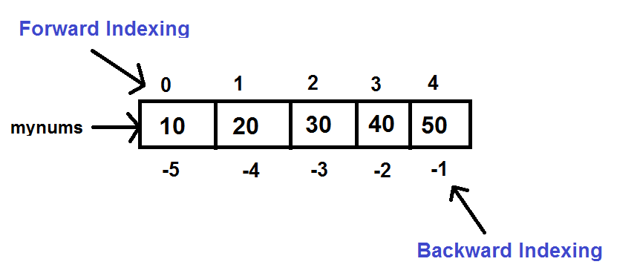
Accessing Individual Elements

Slide 11
Accessing Individual Elements
mynums=[10,20,30,40,50]
print(mynums[0])
print(mynums[1])
print(mynums[-3])
print(mynums[-2])
Output:
10
20
30
40

Slide 12
Accessing List Elements Using While Loop
mynums=[10,20,30,40,50]
n=len(mynums)
i=0
while i<n:
print(mynums[i])
i=i+1
Output:
10
20
30
40
50
Just like len( ) works with strings , similarly it also works with list also and returns number of elements in the list

Slide 13
Accessing List Elements Using For Loop
mynums=[10,20,30,40,50]
for x in mynums:
print(x)
Output:
10
20
30
40
50
Since list is a sequence type , so for loop can iterate over individual elements of the list

Slide 14
Exercise
Redesign the previous code using for loop only to traverse the list in reverse order. Don’t use slice operator

Slide 15
Solution
mynums=[10,20,30,40,50]
n=len(mynums)
for i in range(n-1,-1,-1):
print(mynums[i])
Output:
50
40
30
20
10

Slide 16
Adding New Data In The List
The most common way of adding a new element to an existing list is by calling the append( ) method.
This method takes one argument and adds it at the end of the list
mynums=[10,20,30,40,50]
print(mynums)
mynums.append(60)
print(mynums)
Output:
[10,20,30,40,50]
[10,20,30,40,50,60]
Remember , lists are mutable . So append( ) method doesn’t create a new list , rather it simply adds a new element to the existing list.
CAN YOU PROVE THIS ?

Slide 17
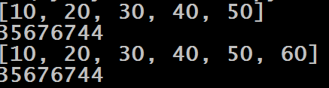
Solution
mynums=[10,20,30,40,50]
print(mynums)
print(id(mynums))
mynums.append(60)
print(mynums)
print(id(mynums))
Output:
As we can see in the both the cases the id( ) function is returning the same address . This means that no new list was created.

Slide 18
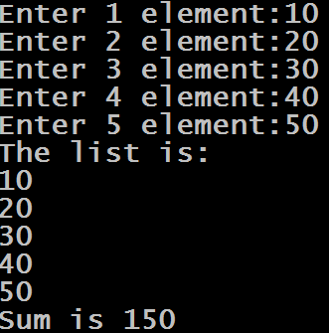
Exercise
Write a program to accept five integers from the user , store them in a list . Display these integers and also display their sum
Output:

Slide 19
Solution
mynums=[]
i=1
while i<=5:
x=int(input("Enter "+str(i)+" element:"))
mynums.append(x)
i=i+1
print("The list is:")
sum=0
for x in mynums:
print(x)
sum+=x
print("Sum is",sum)

Slide 20
Slice Operator With List
Just like we can apply slice operator with strings , similarly Python allows us to apply slice operator with lists also.
Syntax: list_var[x:y]
x denotes the start index of slicing and y denotes the end index . But Python ends slicing at y-1 index.

Slide 21
The Slicing Operator
Example:
mynums=[10,20,30, 40,50]
print(mynums[3:5])
Output:
[40,50]
Example:
mynums=[10,20,30,40,50]
print(mynums[1:4])
Output:
[20,30,40]

Slide 22
The Slicing Operator
Example:
mynums=[10,20,30, 40,50]
print(mynums[0:10])
Output:
[10,20,3040,50]
Example:
mynums=[10,20,30,40,50]
print(mynums[0:4])
Output:
[10,20,30,40]

Slide 23
The Slicing Operator
Example:
mynums=[10,20,30, 40,50]
print(mynums[6:10])
Output:
[ ]
Example:
mynums=[10,20,30,40,50]
print(mynums[2:2])
Output:
[ ]

Slide 24
The Slicing Operator
Example:
mynums=[10,20,30, 40,50]
print(mynums[:3])
Output:
[10,20,30 ]
Example:
mynums=[10,20,30,40,50]
print(mynums[1: ])
Output:
[20,30,40,50 ]

Slide 25
The Slicing Operator
Example:
mynums=[10,20,30, 40,50]
print(mynums[-2:])
Output:
[40,50]
Example:
mynums=[10,20,30,40,50]
print(mynums[ :-2])
Output:
[10, 20,30 ]

Slide 26
The Slicing Operator
Example:
mynums=[10,20,30, 40,50]
print(mynums[-2:-2])
Output:
[]
Example:
mynums=[10,20,30,40,50]
print(mynums[-2:1])
Output:
[ ]

Slide 27
The Slicing Operator
Example:
mynums=[10,20,30, 40,50]
print(mynums[-2:4])
Output:
[40]
Example:
mynums=[10,20,30,40,50]
print(mynums[-2:2])
Output:
[ ]

Slide 28
The Slicing Operator
Example:
mynums=[10,20,30, 40,50]
print(mynums[1:-2])
Output:
[20,30]
Example:
mynums=[10,20,30,40,50]
print(mynums[-4:2])
Output:
[20 ]

Slide 29
The Slicing Operator
Example:
mynums=[10,20,30, 40,50]
print(mynums[-1:-2])
Output:
[ ]
Example:
mynums=[10,20,30,40,50]
print(mynums[-2: -1])
Output:
[40]

Slide 30
Using Step Value
String slicing can accept a third parameter also after the two index numbers.
The third parameter is called step value.
So the complete syntax of slicing operator is:
s[begin:end:step]
Step value indicates how many characters to move forward after the first character is retrieved from the string and it’s default value is 1 , but can be changed as per our choice.

Slide 31
Using Step Value
Another point to understand is that if step is positive or not mentioned then
Movement is in forward direction ( L→R)
Default for start is 0 and end is len
But if step is negative , then
Movement is in backward direction (R→L)
Default for start is -1 and end is –(len+1)

Slide 32
The Slicing Operator
Example:
mynums=[10,20,30, 40,50]
print(mynums[1:4:0])
Output:
ValueError: Slice step cannot be 0
Example:
mynums=[10,20,30,40,50]
print(mynums[1:4:2])
Output:
[20,40]

Slide 33
The Slicing Operator
Example:
mynums=[10,20,30, 40,50]
print(mynums[4:1:-1])
Output:
[50,40,30]
Example:
mynums=[10,20,30,40,50]
print(mynums[4:1:1])
Output:
[ ]

Slide 34
The Slicing Operator
Example:
mynums=[10,20,30, 40,50]
print(mynums[::-1])
Output:
[50,40,30,20,10]
Example:
mynums=[10,20,30,40,50]
print(mynums[::])
Output:
[10,20,30,40,50 ]

Slide 35
The Slicing Operator
Example:
mynums=[10,20,30, 40,50]
print(mynums[::2])
Output:
[10,30,50]
Example:
mynums=[10,20,30,40,50]
print(mynums[::-2])
Output:
[50,30,10 ]

Slide 36
The Slicing Operator
Example:
mynums=[10,20,30, 40,50]
print(mynums[-1:-4:-1])
Output:
[50,40,30]
Example:
mynums=[10,20,30,40,50]
print(mynums[-1:-4:])
Output:
[]

Slide 37
The Slicing Operator
Example:
mynums=[10,20,30, 40,50]
print(mynums[-4:-1:-1])
Output:
[]
Example:
mynums=[10,20,30,40,50]
print(mynums[-4:-1:])
Output:
[20,30,40]

Slide 38
The Slicing Operator
Example:
mynums=[10,20,30, 40,50]
print(mynums[-1::2])
Output:
[50]
Example:
mynums=[10,20,30,40,50]
print(mynums[-1: :-2])
Output:
[50,30,10]

Slide 39
The Slicing Operator
Example:
mynums=[10,20,30, 40,50]
print(mynums[-3::-1])
Output:
[30,20,10]
Example:
mynums=[10,20,30,40,50]
print(mynums[-1:4 :2])
Output:
[]

Slide 40
The Slicing Operator
Example:
mynums=[10,20,30, 40,50]
print(mynums[-1:-1:-1])
Output:
[]
Example:
mynums=[10,20,30,40,50]
print(mynums[:-3:-1])
Output:
[50,40]

